Slide 1
Instacart Market Analysis
Team 6: Griffin Gilder, Rus Thomas, Keming Wu, Tianjie Zhu
Notes:
Good Morning Everyone. We are team 6, and we will be discussing Instacart’s Kaggle competition.

Slide 2
Agenda
01. Instacart & Data Intro
02. Feature Engineering
03. Combine datasets
04. Model Selection
Model Selection, evaluation, and comparison
Notes:
Here is our agenda for today’s presentation, I’ll be discussing Instacart as well as an introduction to our data for this problem.
Rus will discuss our Feature Engineering
Keming will touch on our data splitting and merging techniques
And finally, tianjie talk about each of our models we built as well as their respective evaluations then compare them all

Slide 3

What is Instacart?
Instacart is a personal grocery shopping app. Orders are fulfilled by personal shoppers who pick up, pay, and deliver an individual's groceries. Shoppers are paid fees based on the overall cost of the order.
Notes:
So What is Instacart? Instacart is an app very similar to Uber Eats, Door dash, or grub hub. Except, instead of cooked meals, the products delivered are an individual's groceries. Orders are fulfilled by person shoppers who pick up, pay, and then deliver an individual’s groceries. These shoppers are paid fees based on the overall cost of the order. Depending on the market, Instacart can be much more lucrative than other food delivery apps. Additionally, Instacart became super popular during COVID.

Slide 4
SOLUTION
Problem
To predict which previously purchased products will be in a user’s next order.
Run multiple types of classification to find the best model/approach to predict
Notes:
As previously mentioned, Instacart published their Kaggle competition in May of 2017. The main problem --- To take past data and try and predict which previously purchased products will be in a user’s next order. For us, the solution was quite simple create and run multiple types of regression analysis to find the best model/approach to predict future purchases.

Slide 5
01
Data Introduction
Notes:
Now lets dive into the data.

Slide 6
Data Introduction
6 different csv files
Aisles, department, orders, products, product_train_order, product_prior_order
Determined the datasets are not the same size
Not all prior or train data is in the orders dataset
59% of products have been reordered
Notes:
We have 6 different datasets, aisles, category, orders, products, train_order, and prior_order. We heavily focused on order, train_order, and prior_order. We focused on orders, product_train_order, and product_prior_order.
I need more stuff here I think

Slide 7
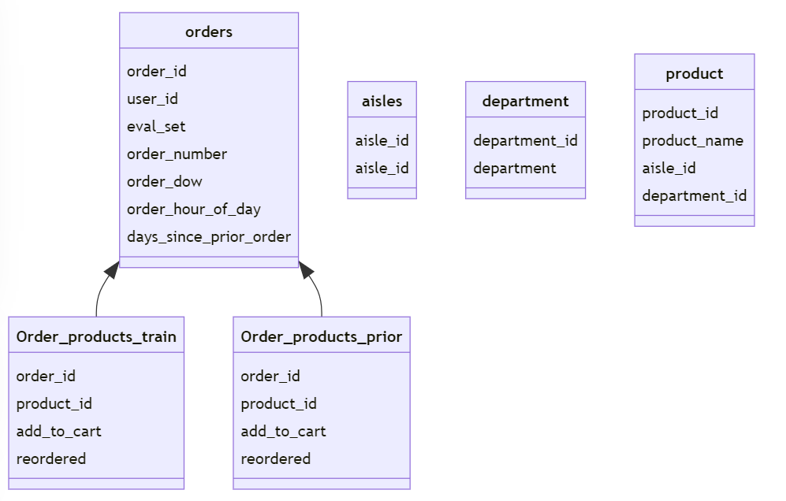
Data Introduction
Orders: 3,421,083*7
Orders_products_train: 1,384,617*4
Orders_product_prior: 32,434,489*4
Notes:
Possible screenshot of every couln
Which ones are binary variables

Slide 8
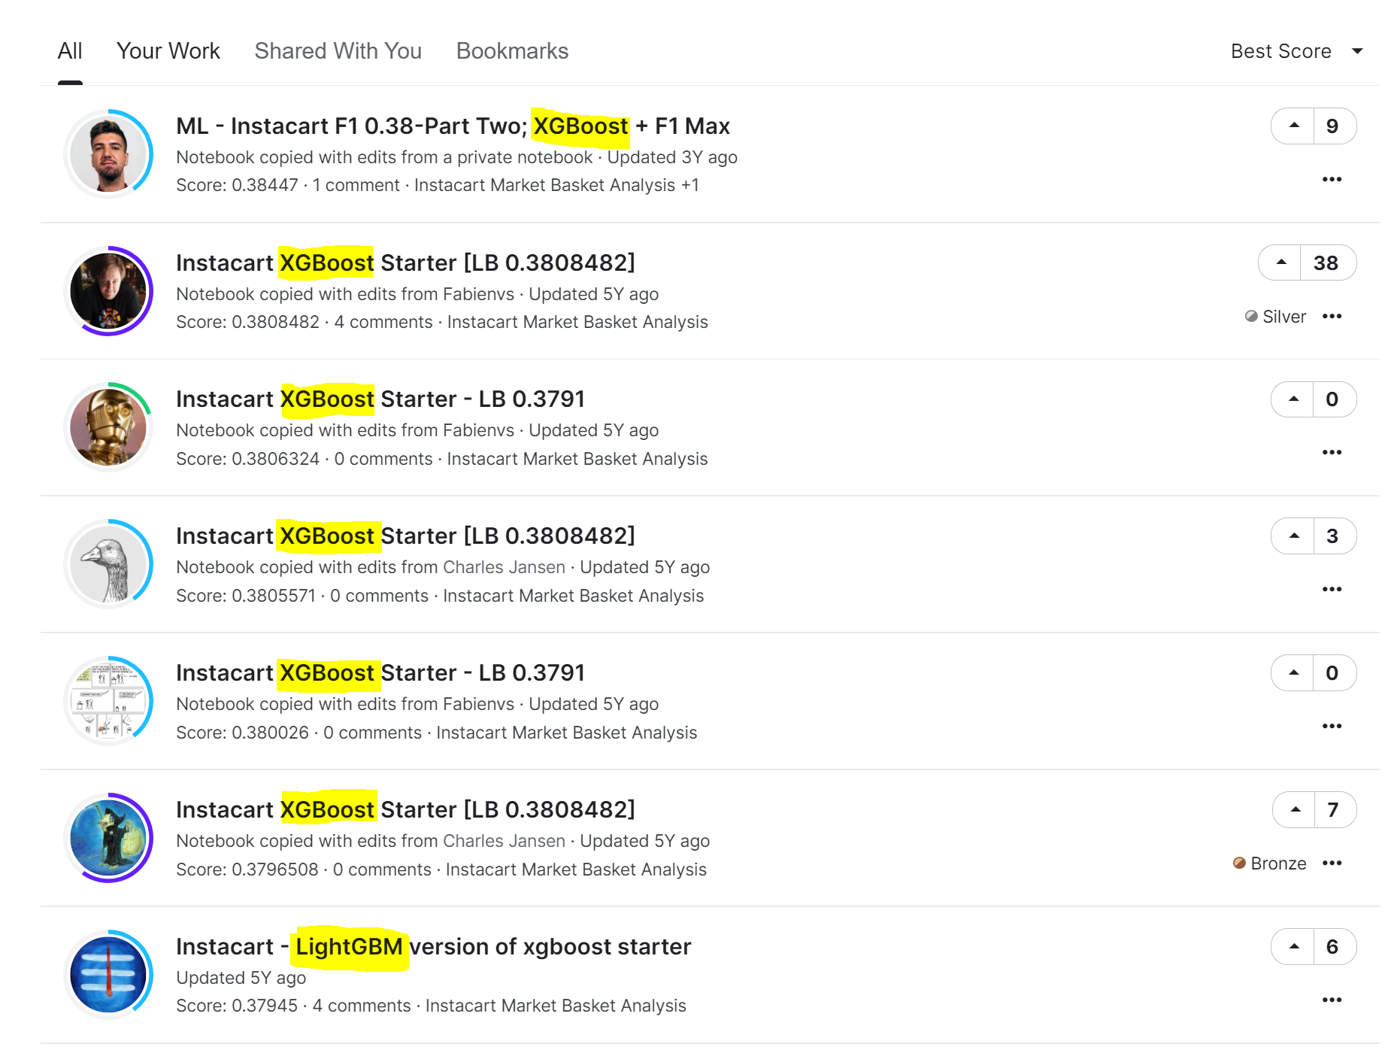
Critique
Notes:
Other methods ----
When looking at how other people approached this problem, we filtered the code tab by best score. We noticed that the first 6 programs all used XGBoost.

Slide 9
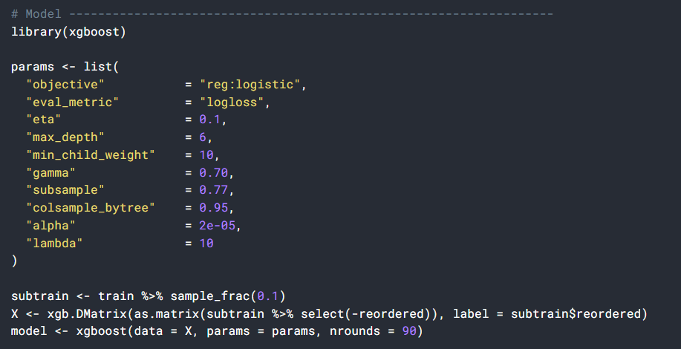
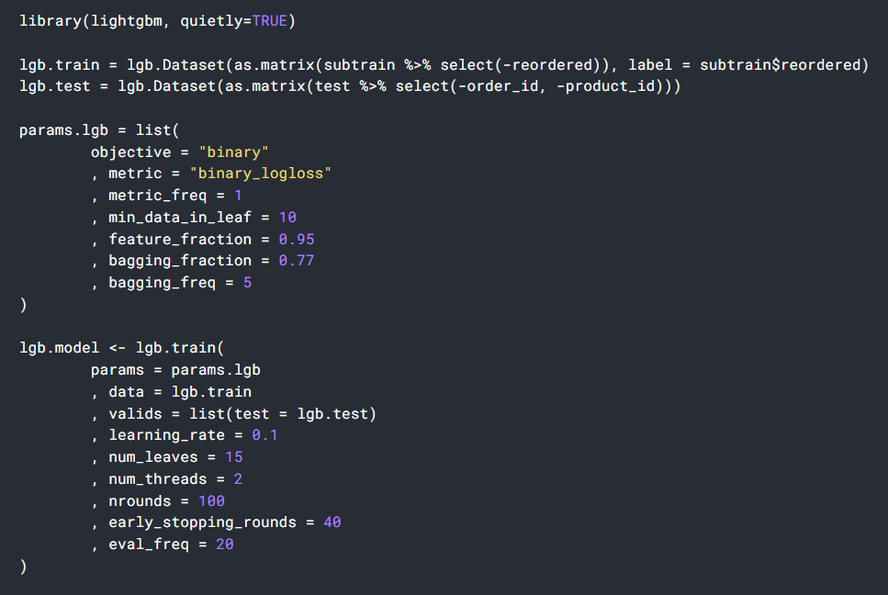
Critique
Notes:
Other methods ----
So, we took a deep dive into one of the XGBoost solutions and one of the lightgbm solutions. While studying and trying to perform XGboost we came across a few things. This type of classification is very computationally comprehensive. And because our dataset was so big we ran into some issues, so we decided it was better off to try another way. We then examined lightgbm models and began to see this was a possible way todo this problem. So we took what a look of quality solutions had done, used lightgbm, and along with other classification techniques we began our analysis.

Slide 10
02
Feature Engineering

Slide 11
Feature Engineering
We considered two main factors in our feature engineering process:
User features, which refer to consumer habits that may influence their reorder behavior
Product features, which refer to the properties of products that may influence the reorder behavior of the consumer

Slide 12
User Features
Number of orders for each users
Shopping frequency
User product preference
Average number of products purchased by a user
Shopping time preference
Reorder mean by user
User shopping frenzy
Notes:
Shopping frequency
Average shopping period since the last time shopping
User product preference
Count of the type of products made by each user
Average number of products purchased by a user for each order
Shopping time preference
The mode of the user order in days of week and hours of day
Reorder mean by user
Mean number of products a user reordered
User shopping frenzy
Maximum number of items purchased by the user in all orders

Slide 13
Product Features
Popularity of the product
The time period in which the product is being purchased most frequently
Reorder mean of each product
Notes:
Popularity of the product
Number of times the product has been purchased
Time period in which the product is being purchased most frequently
Most frequent day in the week and hour in the day
Reorder mean of each product
Mean amount of times a product was reordered across orders
Our product features include the popularity of the product (number of times the product has been purchased), the time period in which the product is being purchased most frequently, and the reorder mean of each product

Slide 14
03
Combine datasets

Slide 15
To get more info from product…
User feature & product feature
product_train
order
LEFT JOIN
LEFT JOIN
Notes:
Only knowing the product information is not enough, we want to know the related order information like when the customer bought it, who bought it. Plus the user feature and product feature we just calculated,so we did left join twice to combine all the information together. This way we got a complete dataset.

Slide 16

Labeling new product_train
product_train PRO
Before
NOW
product_prior
Condition: train.(use_id & product_id) = prior.(use_id & product_id)

Slide 17
Data subset
{
70% training
product_train PRO
5% sample
product_train PRO
30% testing

Slide 18
04
Model Selection, evaluation, comparison
Notes:
We chose three algorithms in this case: SVM, Random Forest, and LightGBM. The reason why we chose those models based on the complexity and nonlinear of consumer behavior, which cannot be explained very well by linear models

Slide 19
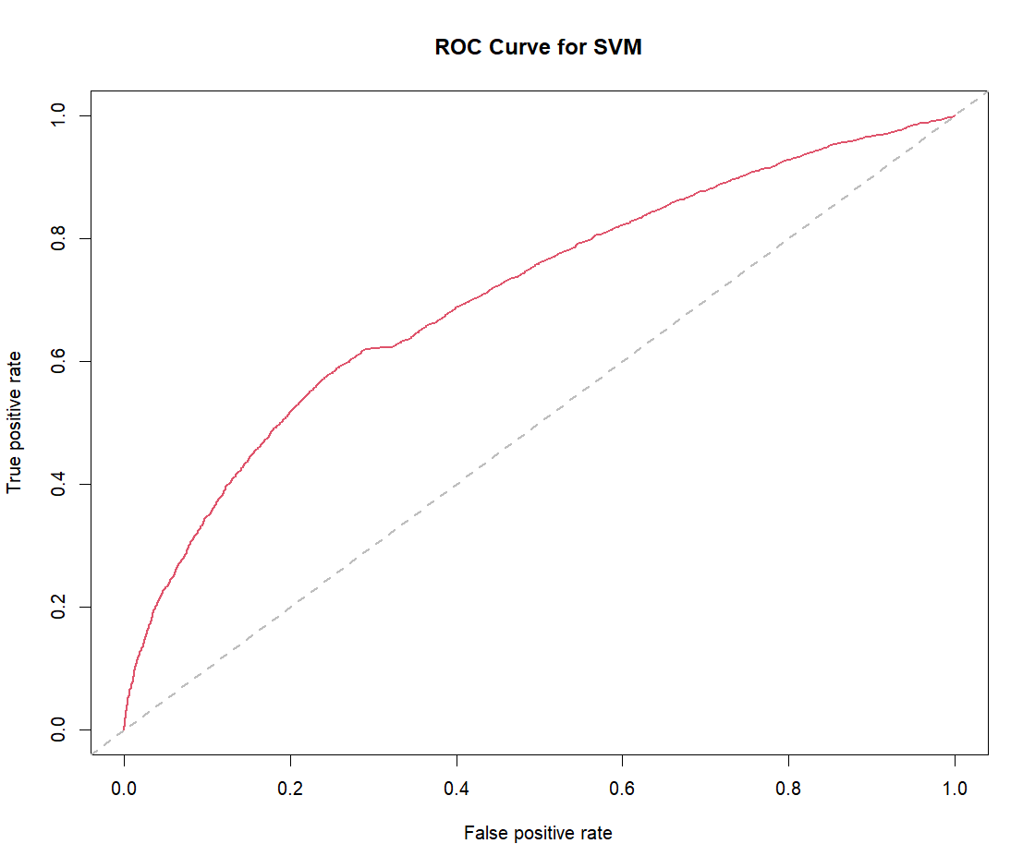
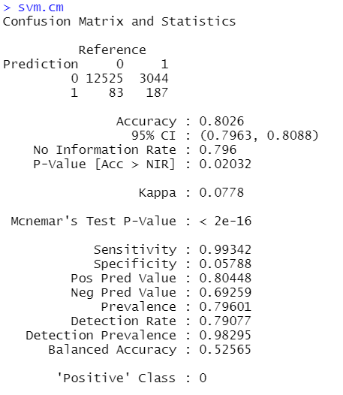

SVM
svm.cart <- svm(label~.-user_id-product_id-order_id, data=train_data_final, cost=2, scale=TRUE)
pred.svm <- predict(svm.cart,valid_data_final)
svm.cm <- confusionMatrix(pred.svm,valid_data_final$label)
Recall: 187/(3044+187) = 5.79%
Notes:
Train with normal size and param
Too long, memory blow
Try
Delete intermediate var (for mem)
Gc (for mem)
Use smaller param / simpler model architecture (too long)
Problem persist
Decrease size of the data
Check label
Use smaller param

Slide 20
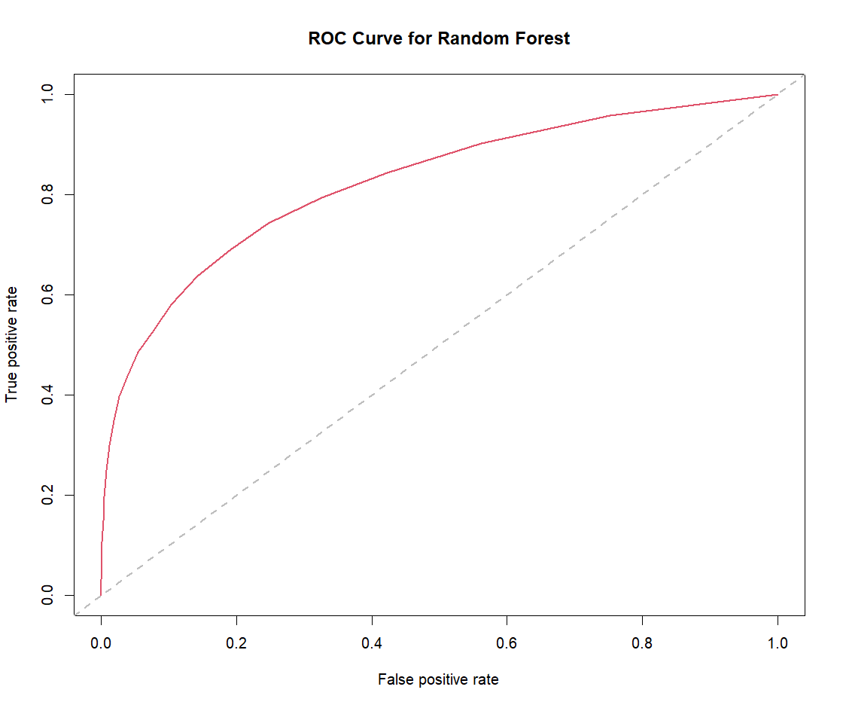
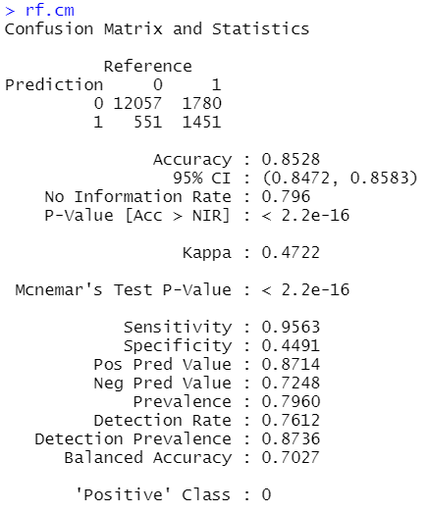
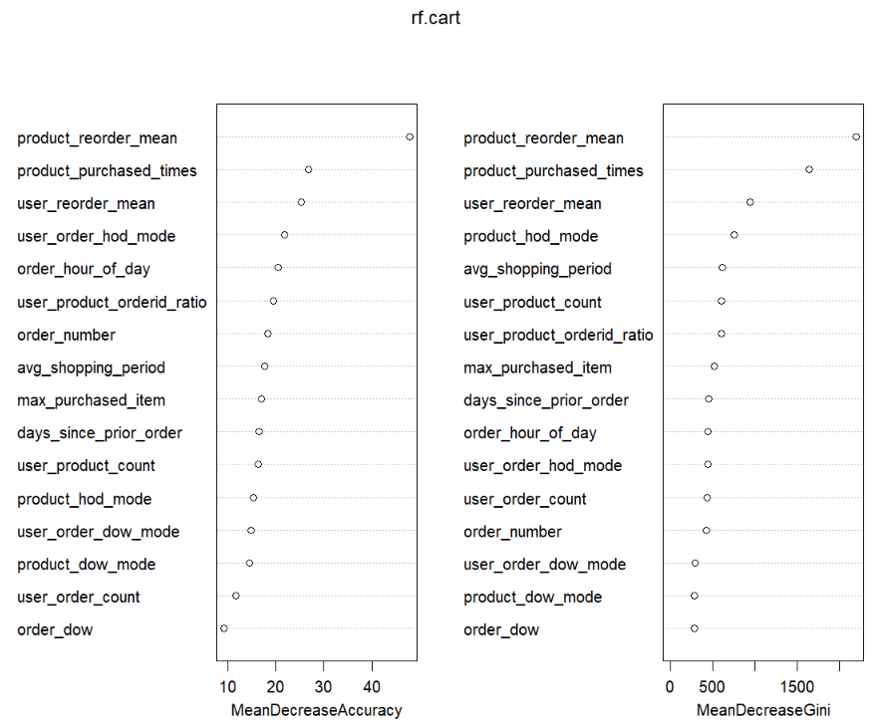

Random Forest
rf.cart <- randomForest(label~.-user_id-product_id-order_id, data=train_data_final, importance=TRUE, ntree = 20, mtry=4)
pred.rf <- predict(rf.cart,valid_data_final)
rf.cm <- confusionMatrix(pred.rf,valid_data_final$label)
Recall: 1451/(1451+1780) = 45.6%
Notes:
By seeing the importance of each variable, whether the product has been reordered before and the total purchased times of each product matters most.

Slide 21
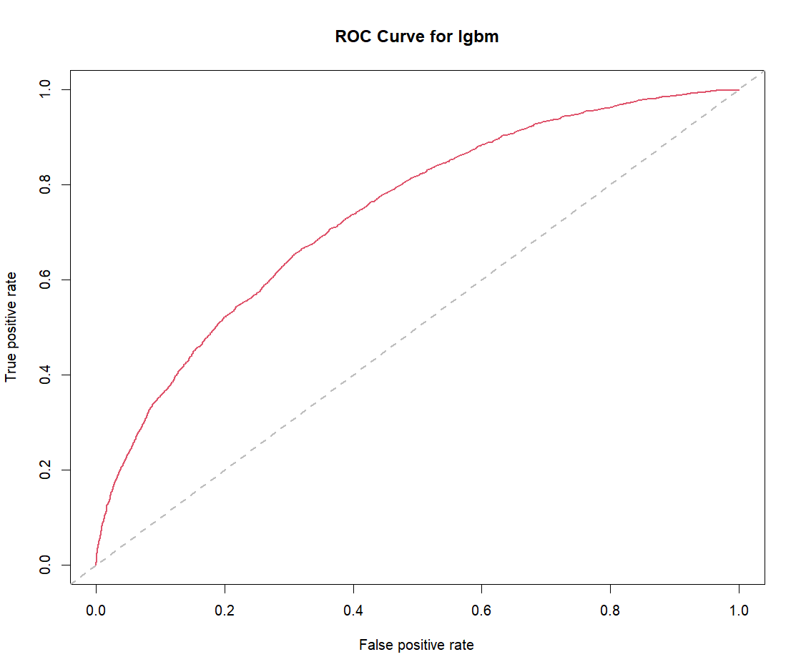
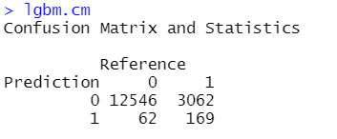

Light GBM
dtrain_matrix <- as.matrix(train_data_final[c(-3)])
dtrain_label <- as.vector(train_data_final$label)
dtrain <- lgb.Dataset(dtrain_matrix, label = dtrain_label)
dtest_matrix <- as.matrix(valid_data_final[c(-3)])
dtest_label <- as.vector(valid_data_final$label)
dtest <- lgb.Dataset.create.valid(dtrain, dtest_matrix, label = dtest_label)
valids <- list(test = dtest)
params = list(max_bin = 100,
learning_rate = 0.1,
objective = "binary",
metric = 'binary_logloss')
lgbm.cart <- lgb.train(
params = params,
data = dtrain,
nrounds = 20,
valids = valids)
Recall:
169/(3062+169) = 5.23%

Slide 22
Model Comparison
 | SVM | Random Forest | Light GBM
RUN TIME | 4.71 mins | 2.71 secs | 0.26 secs
RECALL RATE | 5.79% | 45.6% | 5.23%
AUC | 0.7008 | 0.8122 | 0.7358
Notes:
Recall rate is related with data distribution and thresholds, since it is a binary classification problem, we prefer to use AUC to test the performance of the classifier,

Slide 23
Next Step
Adjust and try to find the optimal parameters
Try on the whole dataset
Try other models

Slide 24
THANKS!
Questions?

